Slide 1
SCSI1113: COMPUTATIONAL MATHEMATICS
CHAPTER 6
Non-Linear Equations
2014/2015 – Semester 2

Slide 2
Outline
6.1: Introduction
6.2: Solution for NLE
6.3: Intermediate Value Theorem
6.4: Bisection Method
6.5: False Position Method
6.6: Secant Method
6.7: Newton’s Method

Slide 3
Introduction
Finding a solution to an equation f(x), is finding the value of x when f(x)=0.
For a linear equation, we can bring x to the left of equation to solve it.
For a quadratic equation (polynomial degree=2), we can factorise it to solve the equation.

Slide 4
Introduction
How about if the equation is a polynomial with degree >2?

Slide 5
NLE Solution using Numerical Method
Two kinds of numerical method to solve NLE:
  Bracketing methods:
    Need to solve intermediate value theorem first
    Bisection Method
    False Positive Method
  Fixed-Point iteration method
    Secant Method
    Newton’s Method

Slide 6
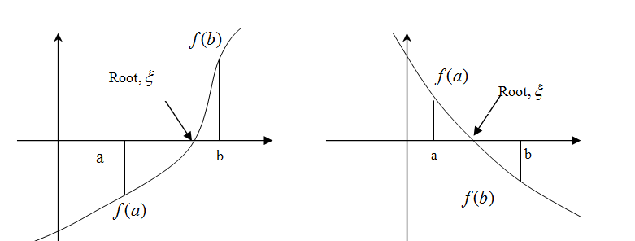
Intermediate Value Theorem
Definition:
If f(x) is a continuous function at interval [a,b] and f(a) and f(b) is on opposite direction or sign, f(a).f(b) < 0 therefore a root, ξ is exist between the interval ξ [a,b].

Slide 7
Example 1
Using the intermediate value theorem, check whether contains real root in interval:
  [-1,0]
  [0,1]
  [1,2]

Slide 8
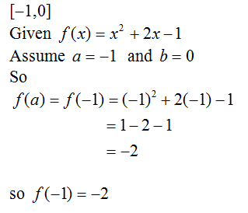
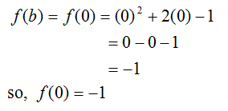
Solution (i): [-1,0]
Since both value of f(a) and f(b) is negative and does not meet intermediate value theorem, so there is no real root in interval [a,b] that is [-1,0].

Slide 9
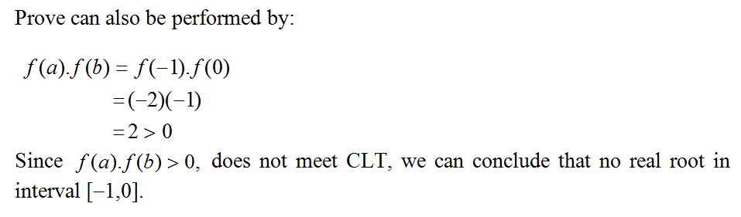
Solution (i): [-1,0] (cont.)
Since f(a). f(b) > 0, does not meet intermediate value theorem, we conclude that no real root in interval [-1,0].

Slide 10
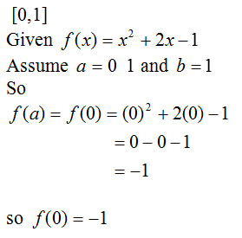
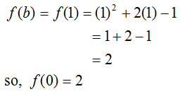
Solution (ii) : [0,1]
Both value of f(a) and f(b) do not in same sign or direction, that is
both in opposite direction. Since intermediate value theorem is
meet, so there at least one real root for the continuous function f(x)
in interval [0,1].

Slide 11
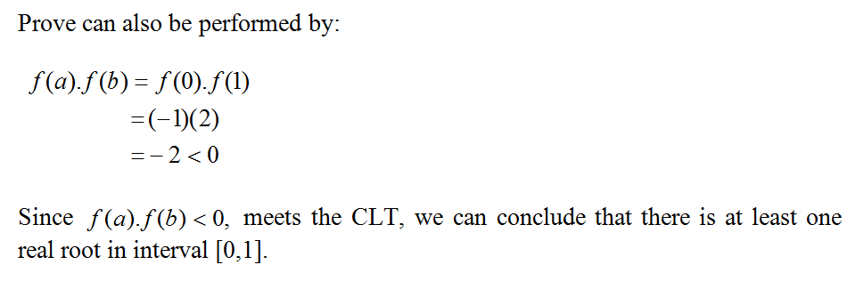
Solution (ii): [0,1] (cont.)
Since f(a). f(b) < 0, meet the intermediate value theorem, we conclude that there is at least one real root in interval [0,1].

Slide 12
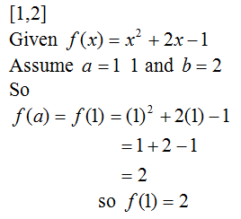
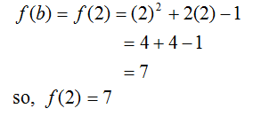
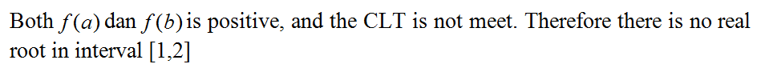
Solution (iii) : [1,2]
Since both value of f(a) and f(b) is positive and does not meet intermediate value theorem, so there is no real root in interval [a,b] that is [1,2].

Slide 13
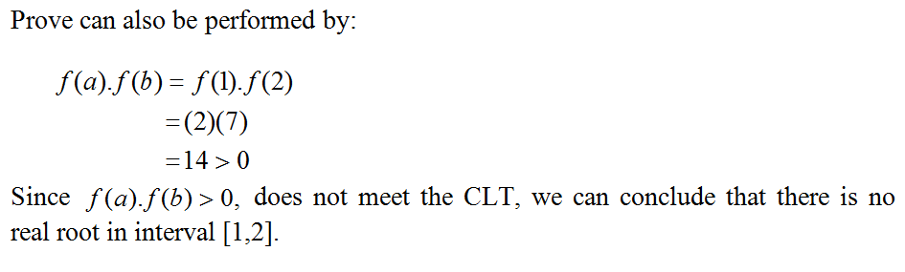
Solution (iii) : [1,2] (cont.)
Since f(a). f(b) > 0, does not meet intermediate value theorem, we conclude that no real root in interval [1,2].

Slide 14
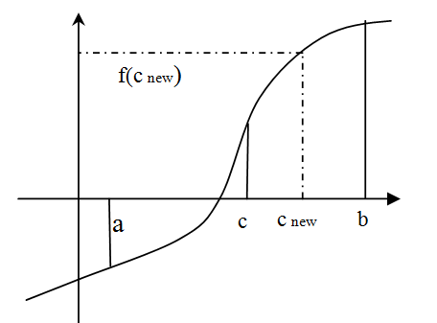
Bisection Method
Have to check intermediate value theorem first.
The root can be obtained through midpoint
for [a,b] which is

Slide 15
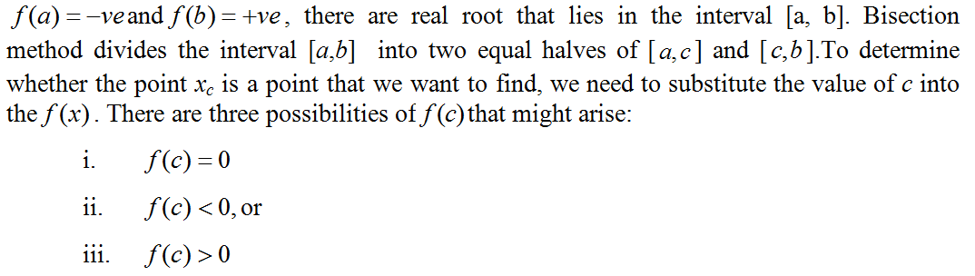
Bisection Method (cont.)
If f(c) = 0, then c = root.
Otherwise, compute new c:

Slide 16
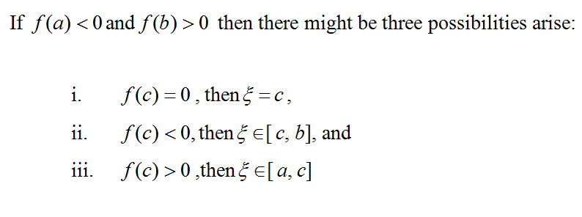
Bisection Method (cont.)

Slide 17
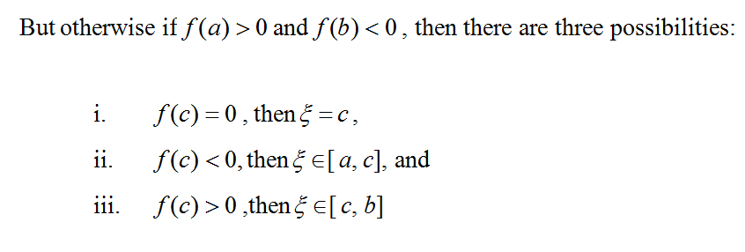
Bisection Method (cont.)

Slide 18
Convergence Criteria
When the root is determined by indirect methods, the real root that obtained through iteration process is repeated until the root was discovered in a specified accuracy limits.
This limit is called the convergence criteria which is usually obtained by the following procedure:
  Define ε > 0. Stops when the absolute value of the
  function at a point which is less than ε: | f(x_{k} ) | < ε
  Specify a number > 0. Stops when the absolute value
  of difference between two successive approximation x_{k}
  and x_{k+1}is less than ε : | x_{k} ₋ x_{k+1}| < ε

Slide 19
Convergence Criteria (cont.)
In addition to the above criteria, we can also use the numerator criteria for determining the number of iteration. The formula is as follows:
This criteria can also be used to stop the equations that have no solution.

Slide 20
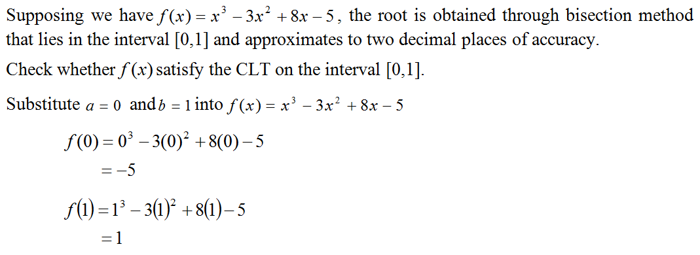
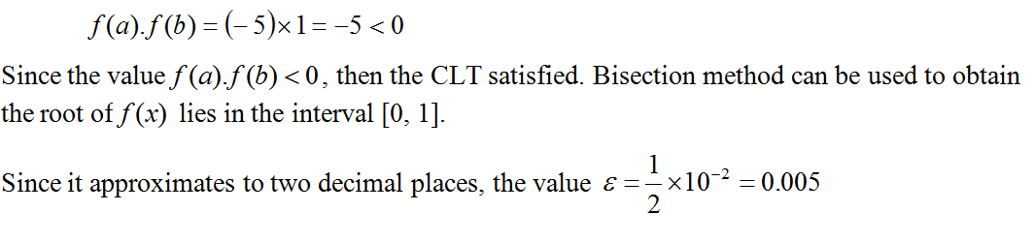
Example 2
Solution

Slide 21
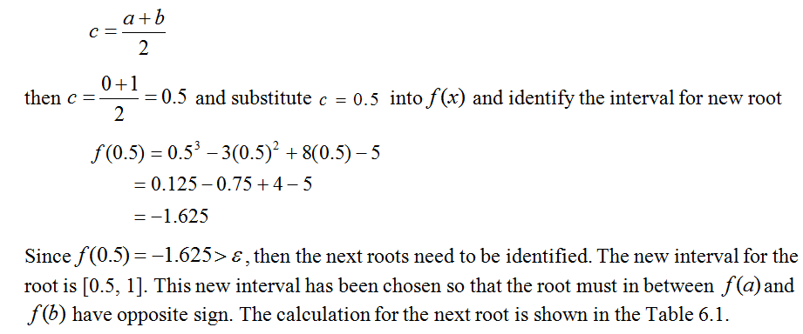
Example 2 (cont.)

Slide 22
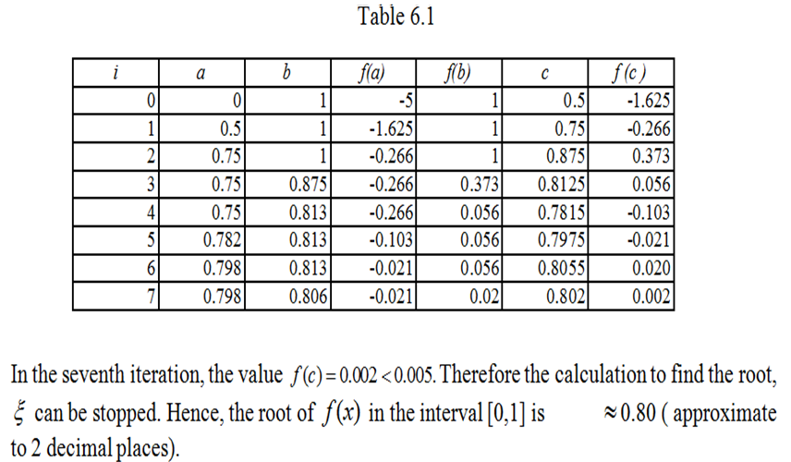
Example 2 (cont.)
0.802

Slide 23
False Position Method
This method is modification of the Bisection method and converges more rapidly than the Bisection method.
Starts with two points a and b such that f(a) and f(b) are of opposite signs, which implies by the intermediate value theorem that the function has a root in the interval.

Slide 24
False Position Method (cont.)
It finds the root from linear interpolation using points a and b or obtains an equation of a straight line connecting f(a) and f(b).
The root is the point where the straight line cuts the x-axis. The process of finding the root is continued until it reaches the required accuracy.
Root of f(x) can be obtained using False Position Method by the following formula:

Slide 25
Example 3
Given , obtain the root using False Position Method over an interval [0,1].
Solution:
Examine whether the function meets the CLT.
Similar to Example 6.3, equation
has opposite signs of f(a) and f(b) values.
Therefore, it cuts x-axis at least at one point
over [0,1] interval.

Slide 26
Example 4 (cont.)
  Since the accuracy of the solution is in 2 d.p, thus
  Using False Position Method,

Slide 27
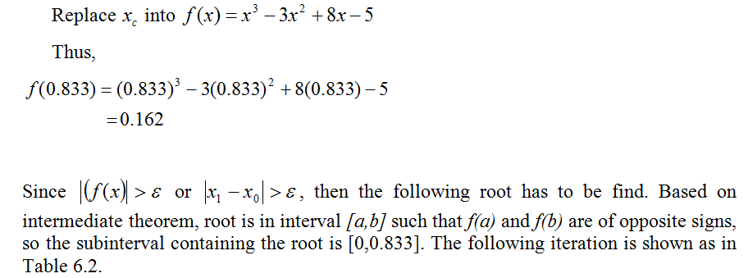
Example 4 (cont.)

Slide 28
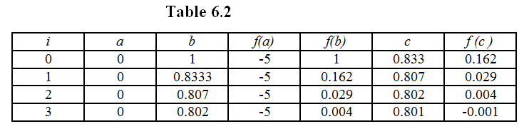
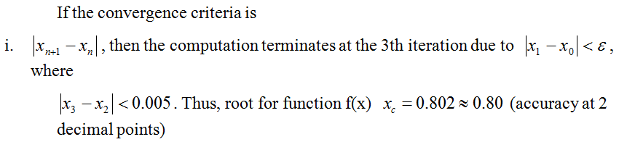
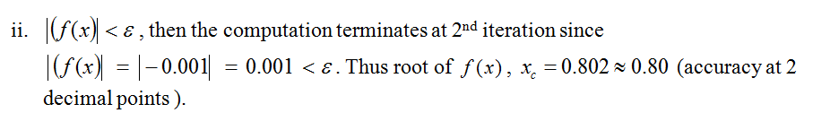
Example 4 (cont.)

Slide 29
EXERCISE
Given a non linear function,
Using intermediate value theorem, check whether there is a root in the following interval:
i) [1, 1.25]
ii) [0.75, 1]
b) Based on the interval in (a), find the root at 3 d.p using
i) Bisection method
ii) False position method

Slide 30
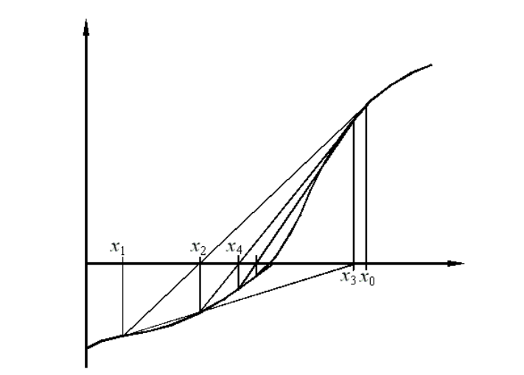
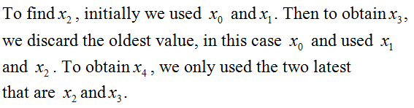
Secant Method
A graphical representation on how the secant method working is shown in figure (a).
Figure (a)

Slide 31
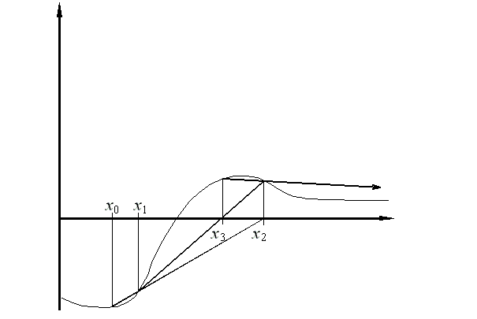
Secant Method (cont.)
Sometimes, the method can diverge instead of converge (see example – Fig.(b)).
Swapping the two initial guesses x₀ and x₁ may change the behaviour of the method from divergent to convergent.
Figure (b): Divergence using the secant method

Slide 32
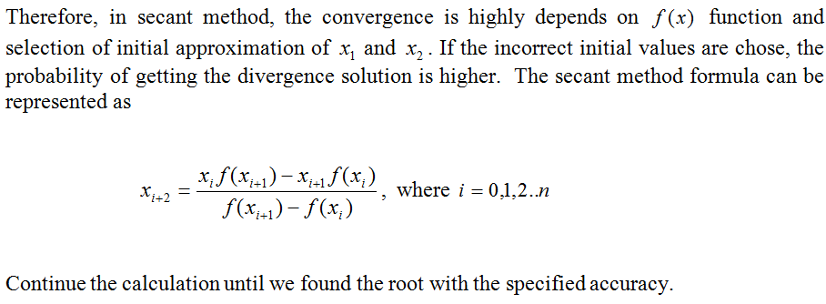
Secant Method (cont.)

Slide 33
Example 5
Solve this function using the secant method.
If the initial guess are x_{o}=1 and x₁=0.
Do calculation correct to 3 decimal points.

Slide 34
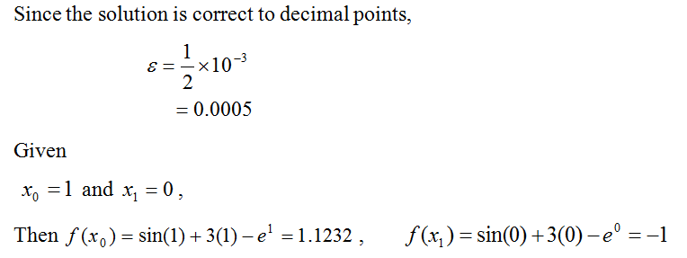
Solution

Slide 35
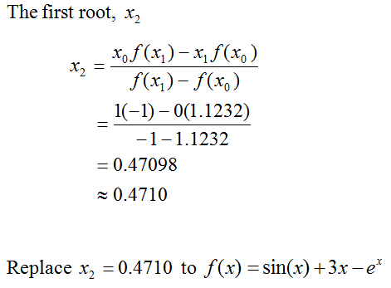
Solution (cont.)

Slide 36
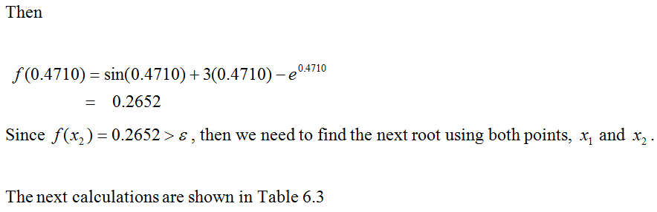
Solution (cont.)

Slide 37
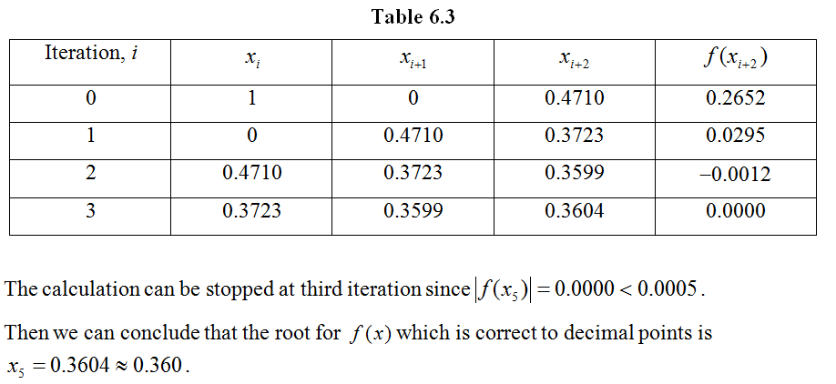
Solution (cont.)

Slide 38
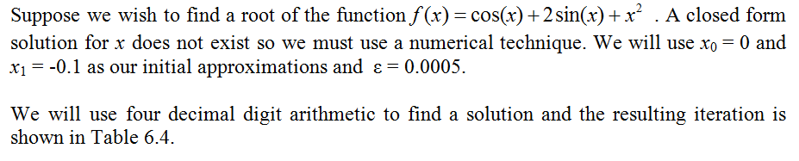
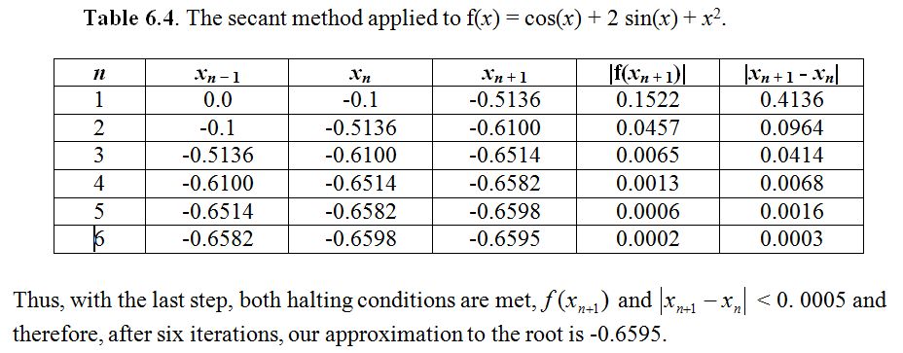
Example 6
Solution:

Slide 39
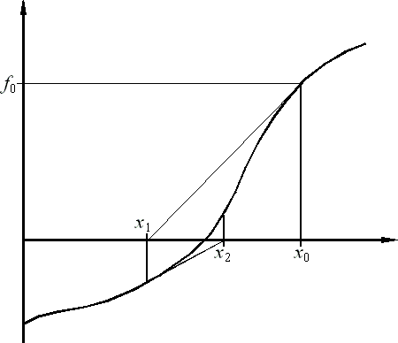
Newton’s Method
Assume that the initial estimate of the zero, x₀ is close to the true root, draw the tangent line to the f(x) at point x₀ and find the next approximation to the zero value, x₁ where the tangent crosses the x-axis.
Then, draw the new tangent line to the curve at the point (x₁, f(x₁)) and as shown in Figure (c), the tangent line is now intersects the x-axis at point x₂.Notice that the point where this tangent crosses the x axis usually represents an improved estimate of the root.
ε
Figure (c): Graphical depiction of Newton’s method

Slide 40
Newton’s Method (cont.)
In general, the Newton Method formula is
where
Although the Newton method is often very efficient compared with the
secant method, there are situations where it performs poorly.
Its convergence depends on the nature of the function and on the accuracy of the initial guess.
The difficulty to get the derivative function can occur when dealing with the complex function.
The Newton approach will often diverge if the initial guesses are not sufficiently close to the true roots or with the poor initial estimate.

Slide 41
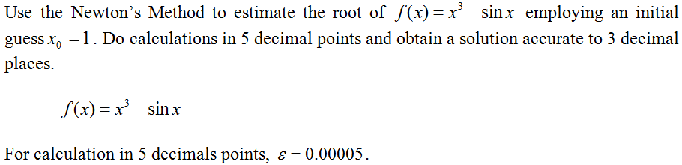
Example 6

Slide 42
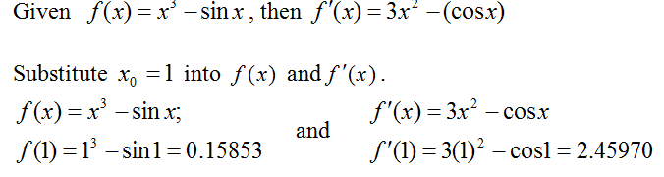
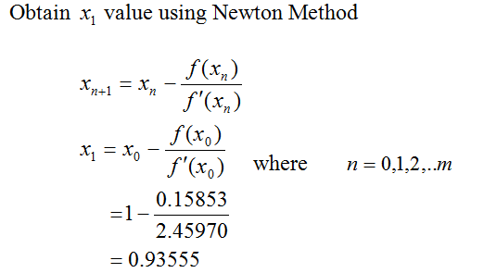
Solution

Slide 43
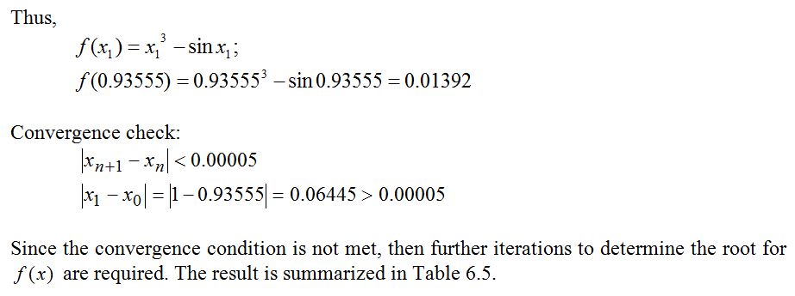
Solution (cont.)

Slide 44
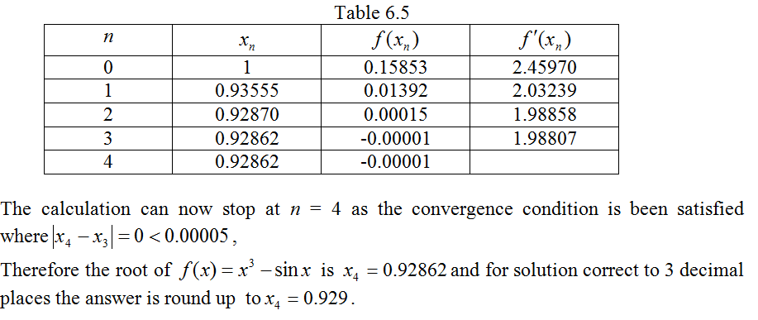
Solution (cont.)

Slide 45
Newton Method with special function x^{n} - c = 0
The Newton Method also can be used for finding the square root of a number.
For example, if one wishes to find the square root of 612, this is equivalent to finding the solution to:
The function to use in Newton's method is,

Slide 46
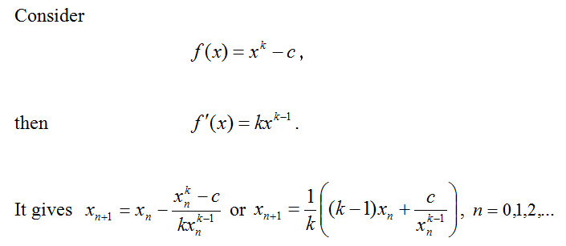
Newton Method with special function x^{n} - c = 0

Slide 47
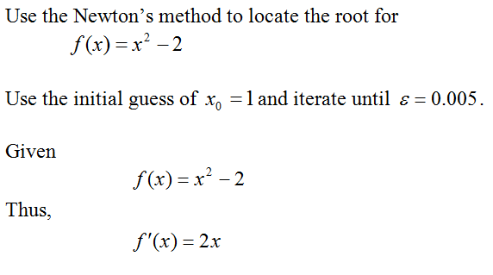
Example 7
Solution:

Slide 48
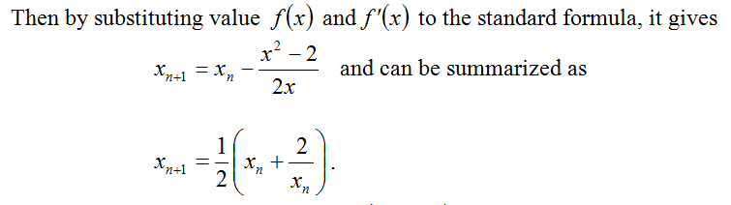
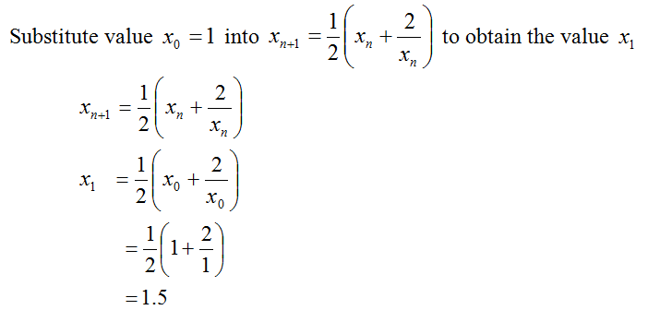
Solution (cont.)

Slide 49
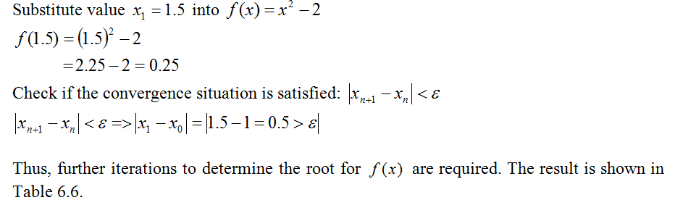
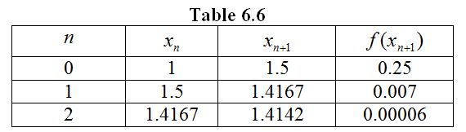
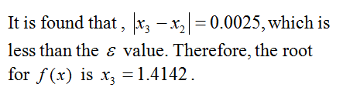
Solution (cont.)

Slide 50
EXERCISES
Find root for the function using
Secant method. Take
Given an equation
Find the root using Newton method.
Take initial value

